Slide 1
Fault Detection of Boiler Emulator
Presented By:
Shima Sadat Naseri student number: 40112814

Slide 2
Content of presentation
01
Dataset information
02
Preprocess
Labeling & Dimension reduction
03
KNN and MLP
04
CNN
05
Hybrid Network (LSTM+CNN)
06
Adding scaler,ReduceLROnPlateau and regularizer
07
Transformer
08
Conclusion

Slide 3
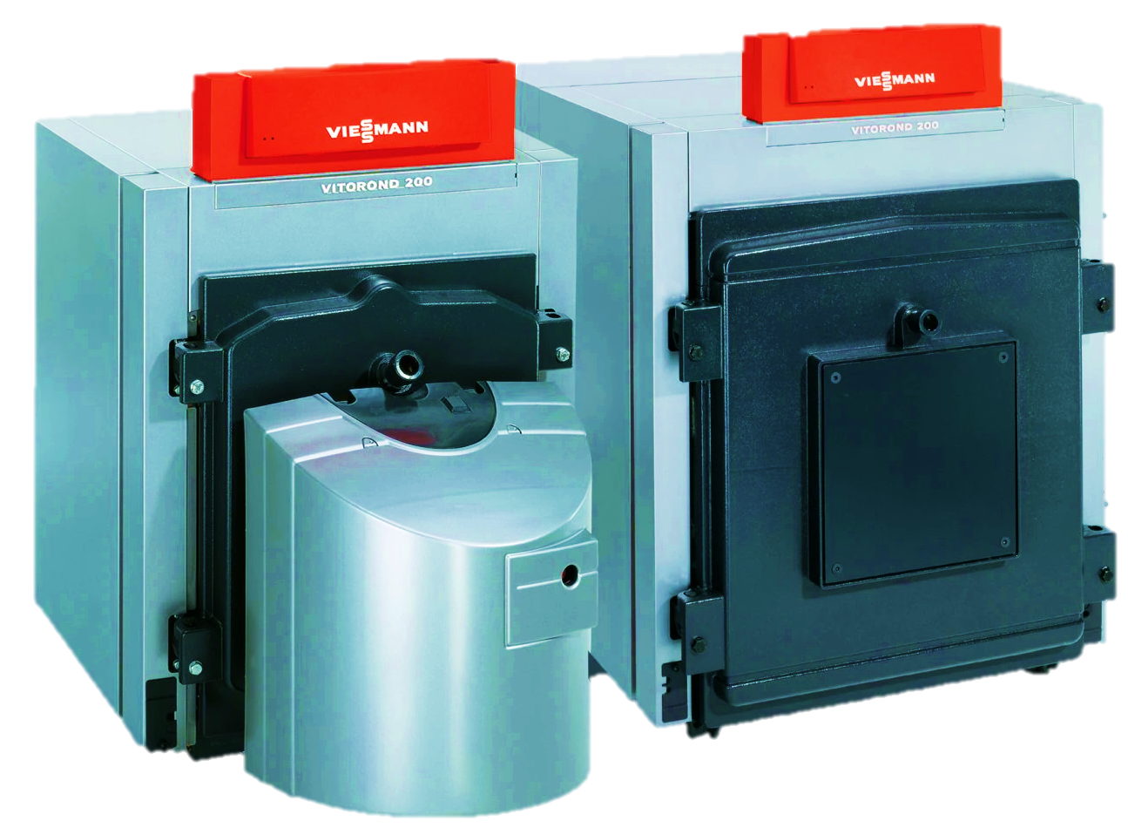
Dataset information
Viessmann Vitorond 200 Gas Fired Boiler VD2 Series 380 Dataset
Emulator Creation:
MATLAB/Simulink based on the Simscape model
Validated with manufacturer test data
Fault Simulation:
1 normal class
4 Fault Types:
Excess Air
Heat Exchanger Fouling
Scaling of Water-side Heat Exchanger
Leaning

Slide 4
Dataset information
Viessmann Vitorond 200 Gas Fired Boiler VD2 Series 380 Dataset
Operating Conditions:
Gas Fuel Rate: 1 kg/s to 4 kg/s
Water Mass Flow Rate: 3 kg/s to 12.5 kg/s
Combustion Air Temperature: 283 K to 303 K
Sampling Method:
Factorial Sampling
Total of 27,281 simulations
Dataset Contents:
Visible Points to Building Automation System
Condition (Detailed Class)
Class (Fault Category)
6 features in total

Slide 5
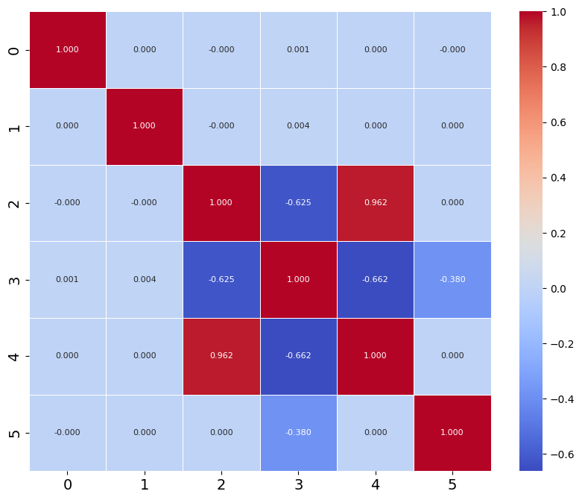
Dataset information
Features:
Fuel_Mdot
T air
T return
T supply
Water_Mdot
Condition

Slide 6

Preprocess
Labeling
Normal: 0
Lean: 1
Excess Air: 2
Fouling: 3
Scaling: 4

Slide 7
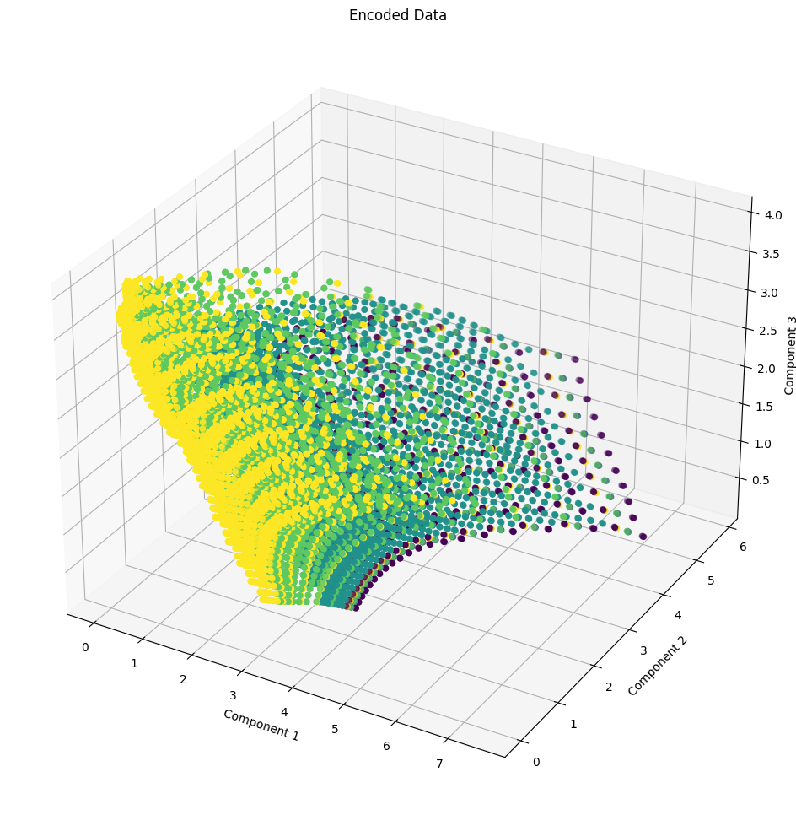
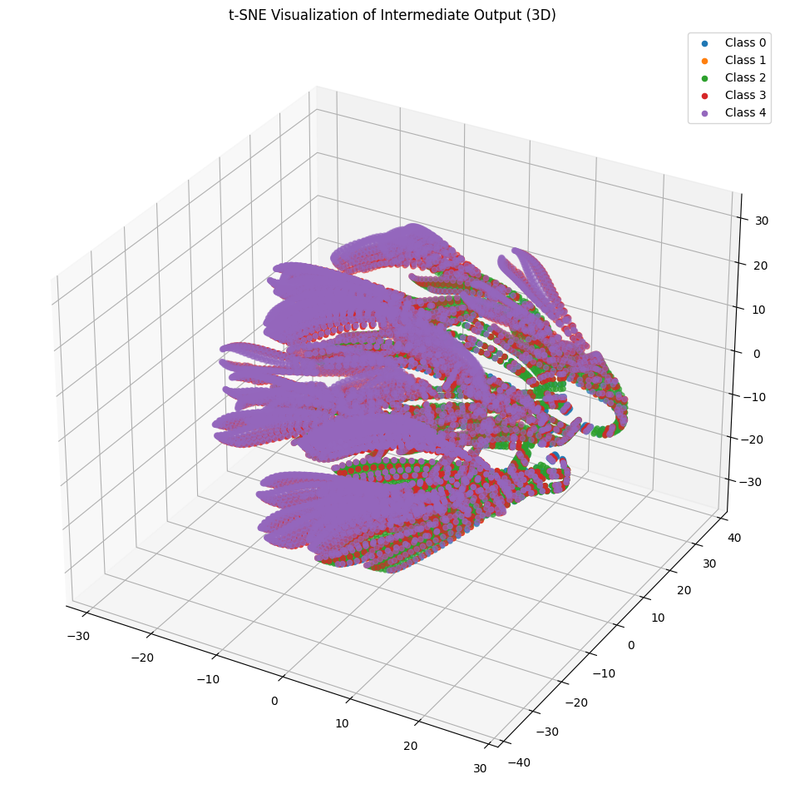
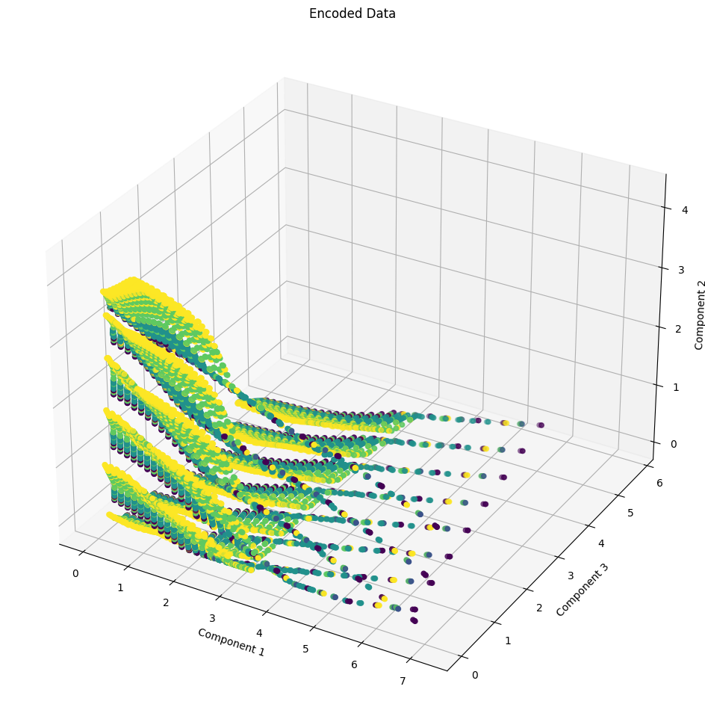
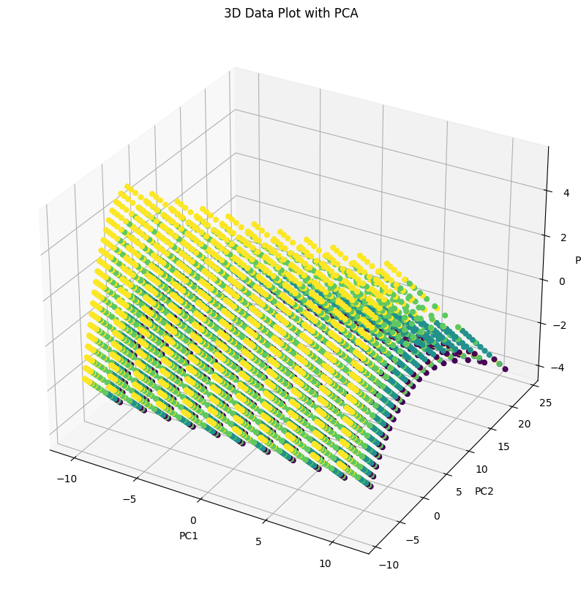
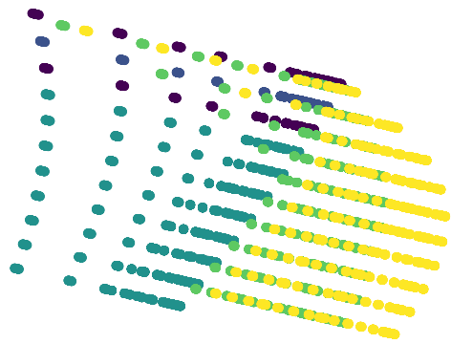
Preprocess
Dimension reduction
Autoencoder
T-SNE
3 component
Random statement=42
3 and 4 features
C
D
LDA
PCA
2 component
3 component

Slide 8
Preprocess
Dimension reduction
Autoencoder
T-SNE
Silhouette Score: -0.034
Calinski-Harabasz Index: 1169
Davies-Bouldin Index: 199
3 features
Silhouette Score: -0.042
Calinski-Harabasz Index: 266
Davies-Bouldin Index: 258
Silhouette Score: -0.017
Calinski-Harabasz Index: 66
Davies-Bouldin Index: 251
4 features
Silhouette Score: -0.025
Calinski-Harabasz Index: 647
Davies-Bouldin Index: 242
D
LDA
PCA
Silhouette Score: 0.052
Calinski-Harabasz Index: 5271
Davies-Bouldin Index: 69
Silhouette Score: -0.025
Calinski-Harabasz Index: 657
Davies-Bouldin Index: 240

Slide 9
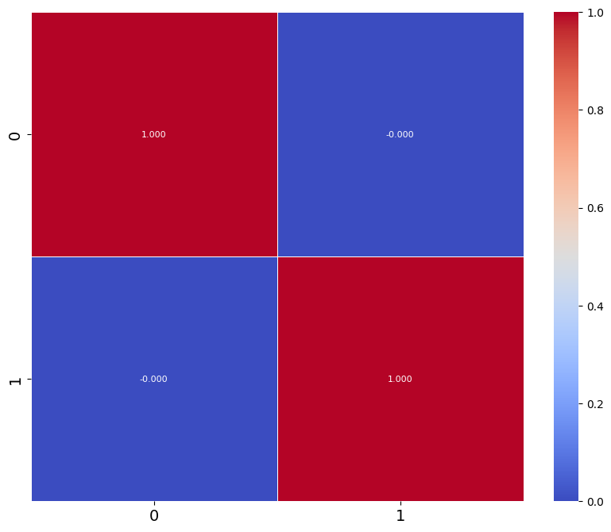
Preprocess
Dimension reduction
Correlation of output
D
LDA
Silhouette Score: 0.052
Calinski-Harabasz Index: 5271
Davies-Bouldin Index: 69

Slide 10
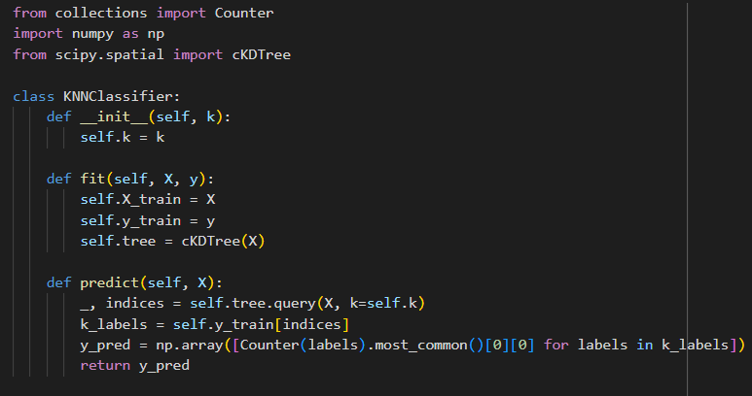
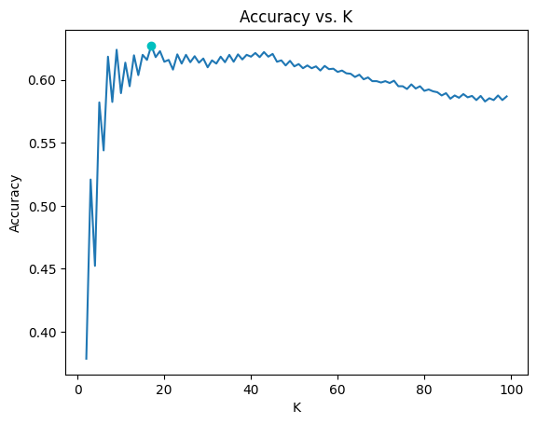
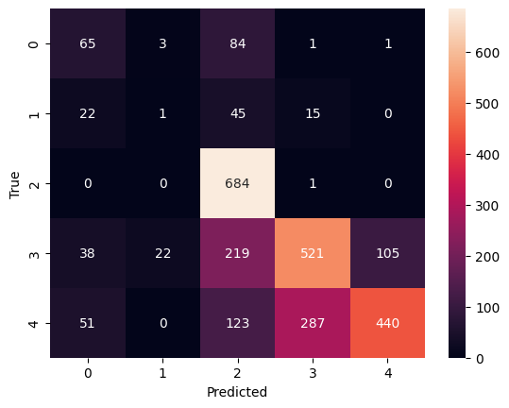
KNN and MLP
KNN
Finding the best K
@ k=17
Cataract Surgery
Training in cataract surgery is one of the key factors needed to ensure high quality cataract surgery with good visual outcomes and patient satisfaction.

Slide 11
KNN and MLP
MLP (on main data and LDA output)
Model Architecture:
Input Shape: (6,1)
Number of Classes: 5
Neural Network:
Dense (32 nodes, ReLU)
Dense (16 nodes, ELU)
Dense (8 nodes, ELU)
Output Dense layer (Softmax)
Model Compilation:
Loss: Sparse Categorical Crossentropy
Optimizer: Adam (Learning rate = 0.01)
Metrics: Accuracy
Model Training:
Batch Size: 32
Epochs: 30
Cataract Surgery
Vitrectomy Surgery
Training in cataract surgery is one of the key factors needed to ensure high quality cataract surgery with good visual outcomes and patient satisfaction.

Slide 12
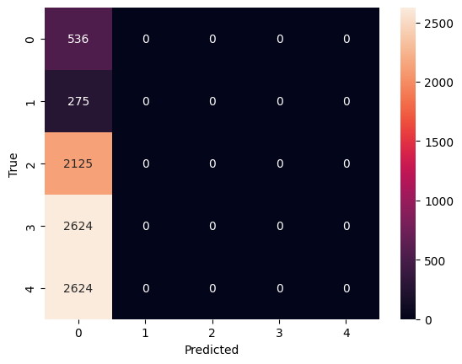
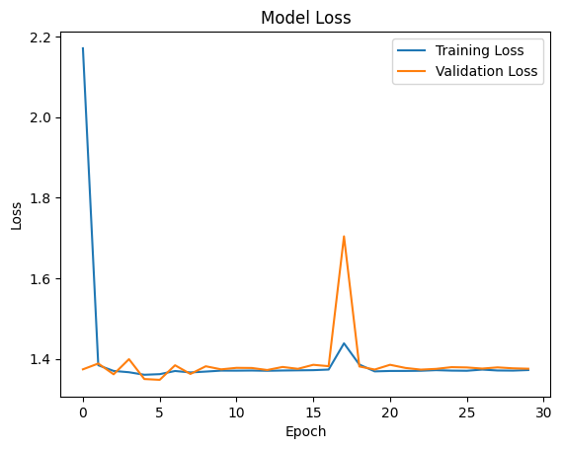
KNN and MLP
MLP (on main data)
Cataract Surgery
Vitrectomy Surgery

Slide 13
CNN
Model Architecture:
Input Shape: (6, 1)
Layers:
Conv1D (64 filters, kernel size=3, ReLU activation)
MaxPooling1D (pool size=2)
Conv1D (32 filters, kernel size=2, ReLU activation)
Flatten the output of the CNN layers
Dense Layer (16 nodes, ReLU activation)
Output Dense Layer with Softmax activation for multi-class classification
Model Compilation:
Loss: Sparse Categorical Crossentropy
Optimizer: Adam (Learning rate = 0.06)
Metrics: Accuracy
Model Training:
Batch Size: 32
Epochs: 30
Cataract Surgery
Vitrectomy Surgery
Training in cataract surgery is one of the key factors needed to ensure high quality cataract surgery with good visual outcomes and patient satisfaction.

Slide 14
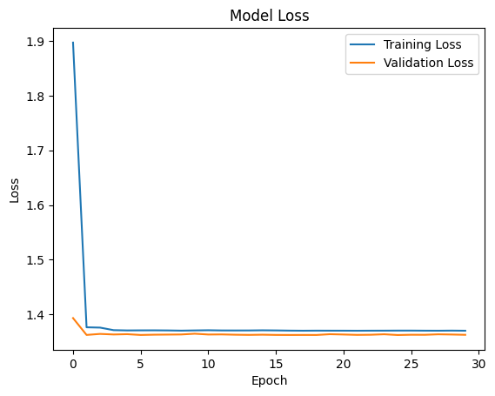
CNN
Cataract Surgery
Vitrectomy Surgery

Slide 15
Hybrid Network (LSTM+CNN)
Model Architecture:
Input Shape: (6, 1)
Layers:
Conv1D (32 filters, kernel size=3, ReLU activation)
MaxPooling1D (pool size=2)
Conv1D (32 filters, kernel size=2, ReLU activation)
LSTM Layer: 16 LSTM units for sequential data processing
Output Dense Layer with Softmax activation for multi-class classification
Model Compilation:
Loss: Sparse Categorical Crossentropy
Optimizer: Adam (Learning rate = 0.04)
Metrics: Accuracy
Model Training:
Batch Size: 32
Epochs: 40
Cataract Surgery
Vitrectomy Surgery
Training in cataract surgery is one of the key factors needed to ensure high quality cataract surgery with good visual outcomes and patient satisfaction.

Slide 16

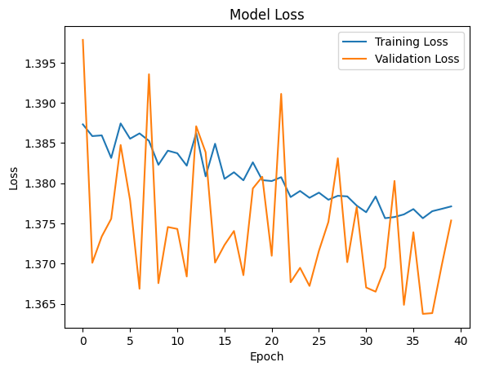
Hybrid Network (LSTM+CNN)
Cataract Surgery
Vitrectomy Surgery

Slide 17
Adding scaler, ReduceLROnPlateau, and regularizer

Slide 18
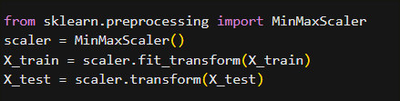
Adding scaler, ReduceLROnPlateau, and regularizer
scaler
MinMaxScaler
Cataract Surgery
Vitrectomy Surgery
Training in cataract surgery is one of the key factors needed to ensure high quality cataract surgery with good visual outcomes and patient satisfaction.

Slide 19
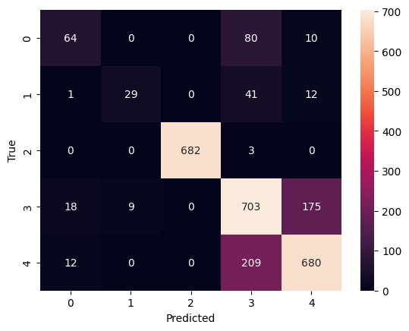
Adding scaler, ReduceLROnPlateau, and regularizer
Scaler in KNN
Cataract Surgery
Vitrectomy Surgery
 | Scaler | No scaler
AUC | 0.79 | 0.69
Recall | 0.79 | 0.62
F1 | 0.79 | 0.62
Precision | 0.79 | 0.62
Training in cataract surgery is one of the key factors needed to ensure high quality cataract surgery with good visual outcomes and patient satisfaction.
K=17
K=9

Slide 20
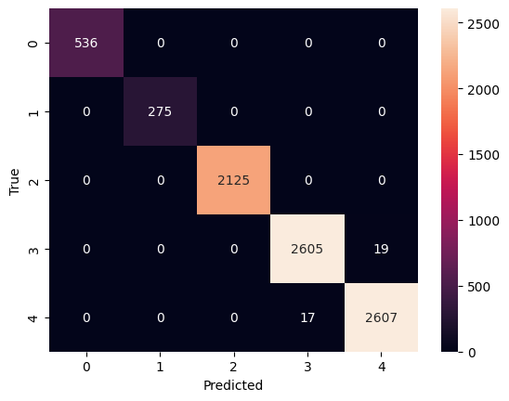
Adding scaler, ReduceLROnPlateau, and regularizer
Scaler in MLP (on main data)
Cataract Surgery
Vitrectomy Surgery
 | Scaler | No scaler
AUC | 0.99 | 0.5
Recall | 0.99 | 0
F1 | 0.99 | 0
Precision | 0.99 | 0

Slide 21
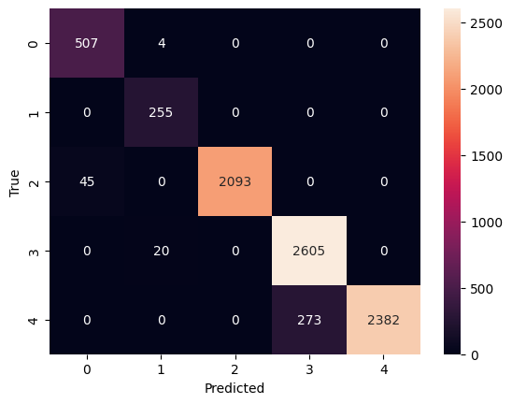
Adding scaler, ReduceLROnPlateau, and regularizer
Scaler in CNN
Cataract Surgery
Vitrectomy Surgery
 | Scaler | No scaler
AUC | 0.98 | 0.5
Recall | 0.95 | 0
F1 | 0.95 | 0
Precision | 0.95 | 0

Slide 22
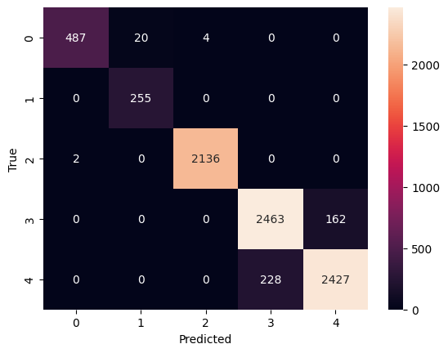
Adding scaler, ReduceLROnPlateau, and regularizer
Scaler in Hybrid network
Cataract Surgery
Vitrectomy Surgery
 | Scaler | No scaler
AUC | 0.97 | 0.5
Recall | 0.94 | 0
F1 | 0.94 | 0
Precision | 0.94 | 0

Slide 23
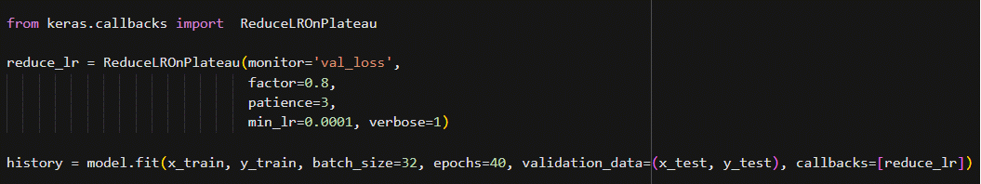
Adding scaler, ReduceLROnPlateau, and regularizer
ReduceLROnPlateau
Dynamic Learning Rate Adjustment
Monitors Validation Metric
Reduces Learning Rate on Plateau
Cataract Surgery
Vitrectomy Surgery
Training in cataract surgery is one of the key factors needed to ensure high quality cataract surgery with good visual outcomes and patient satisfaction.

Slide 24

Adding scaler, ReduceLROnPlateau, and regularizer
ReduceLROnPlateau in MLP
Cataract Surgery
Vitrectomy Surgery
 | without | with
AUC | 0.9979 | 0.9989
Recall | 0.9956 | 0.9976
F1 | 0.9956 | 0.9976
Precision | 0.9956 | 0.9976

Slide 25

Adding scaler, ReduceLROnPlateau, and regularizer
ReduceLROnPlateau in CNN
Cataract Surgery
Vitrectomy Surgery
 | without | with
AUC | 0.98 | 1
Recall | 0.95 | 1
F1 | 0.95 | 1
Precision | 0.95 | 1

Slide 26

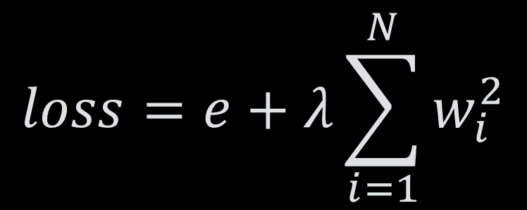
Adding scaler, ReduceLROnPlateau, and regularizer
regularizer
Kernel Regularizer:
Prevents Overfitting
Penalizes Large Weights (L1 or L2)
Regularization Strength: λ
Bias Regularizer:
Penalizes Large Biases
Helps Generalization
Regularization Strength: λ
$$loss=e+λ\sum_{i=1}^{N}{w_{i}^{2}}$$
Cataract Surgery
Vitrectomy Surgery
Training in cataract surgery is one of the key factors needed to ensure high quality cataract surgery with good visual outcomes and patient satisfaction.
$$new bias=old bias+λ\sum_{i=1}^{N}{b_{i}^{2}}$$

Slide 27
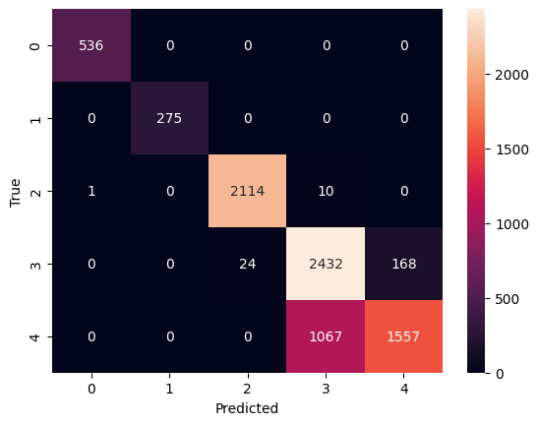
Adding scaler, ReduceLROnPlateau, and regularizer
ReduceLROnPlateau and regularizer in MLP (on LDA output)
Cataract Surgery
Vitrectomy Surgery
 | without | with
AUC | 0.5 | 0.92
Recall | 0 | 0.84
F1 | 0 | 0.84
Precision | 0 | 0.84

Slide 28
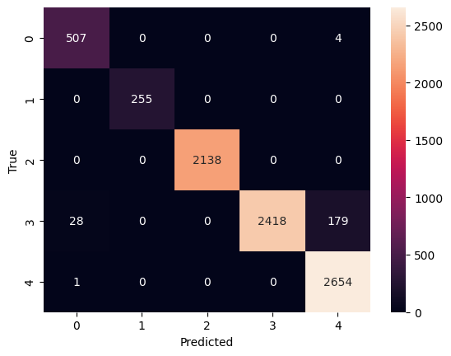
Adding scaler, ReduceLROnPlateau, and regularizer
ReduceLROnPlateau and regularizer in Hybrid network
Cataract Surgery
Vitrectomy Surgery
 | without | with
AUC | 0.97 | 0.98
Recall | 0.94 | 0.97
F1 | 0.94 | 0.97
Precision | 0.94 | 0.97

Slide 29
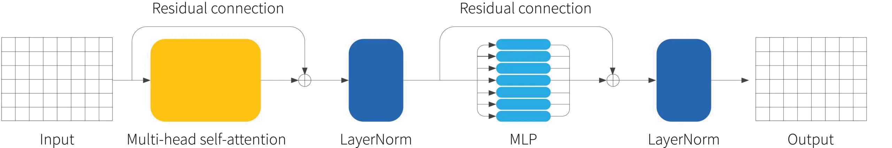
Transformer
Cataract Surgery
Transformer Encoder Architecture:
A custom function transformer_encoder creates a transformer-based model for classification
The model consists of Dense layers with ReLU activation functions to capture input features
Multi-Head Attention (Scaled Dot-Product Attention) is applied for learning relationships between input elements
Model Compilation:
Loss: Sparse Categorical Crossentropy
Optimizer: Adam (Learning rate = 0.01)
Metrics: Sparse Categorical Accuracy
Early Stopping in 10 epoch
trained for 100 epochs
applying early stopping after each epoch
Training in cataract surgery is one of the key factors needed to ensure high quality cataract surgery with good visual outcomes and patient satisfaction.

Slide 30
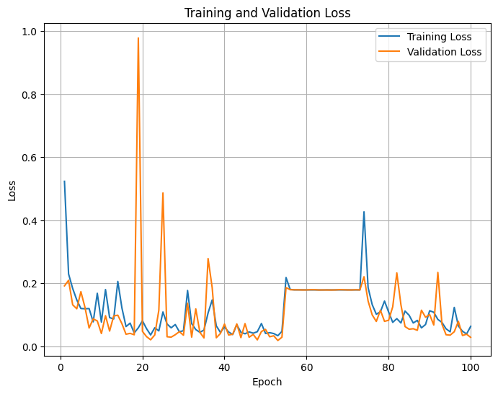

Transformer
Cataract Surgery
AUC | 0.99
Recall | 0.99
F1 | 0.99
Precision | 0.99

Slide 31
Conclusion

Slide 32
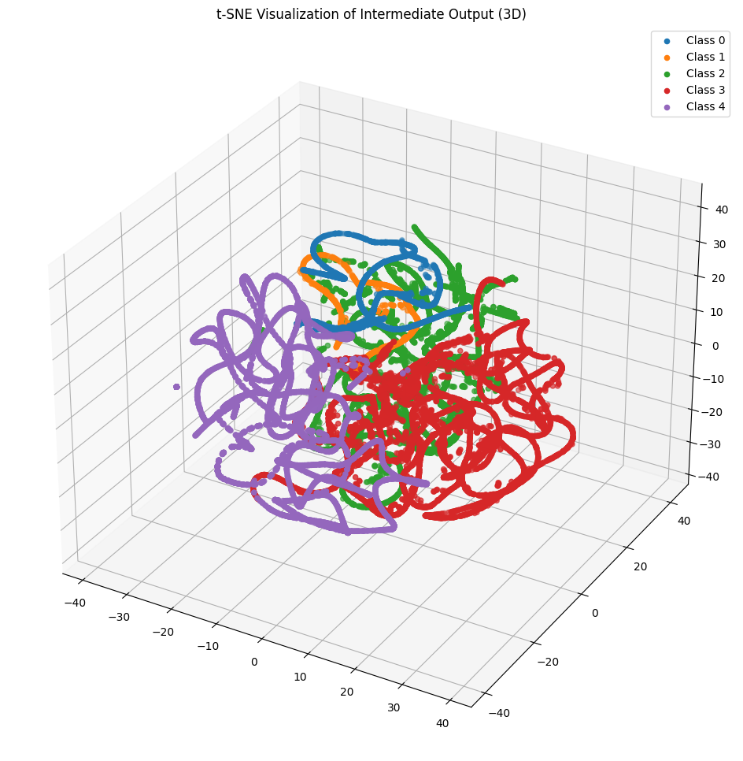
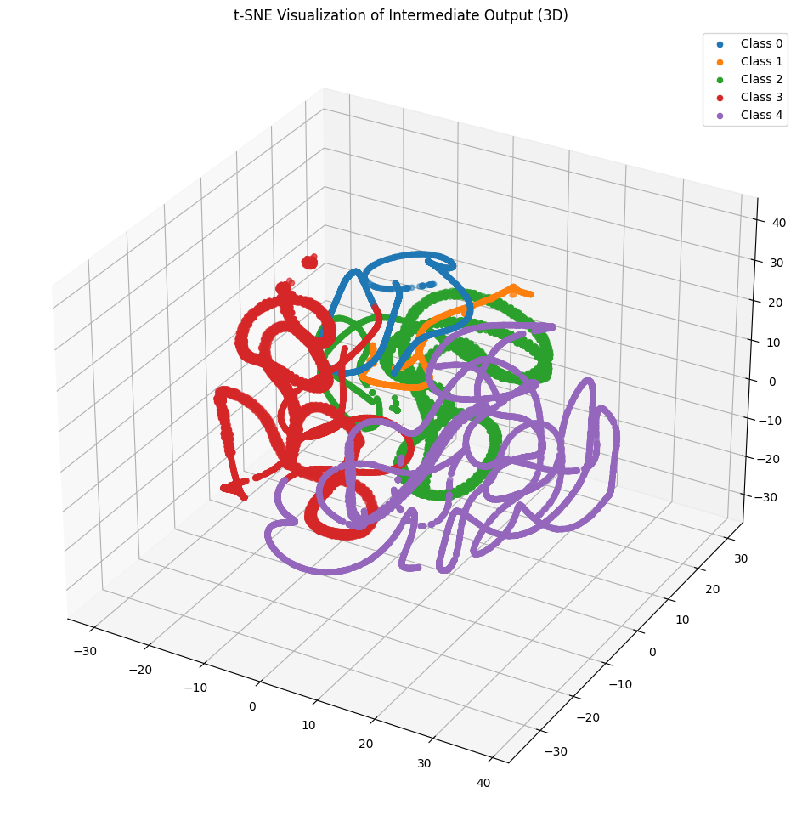
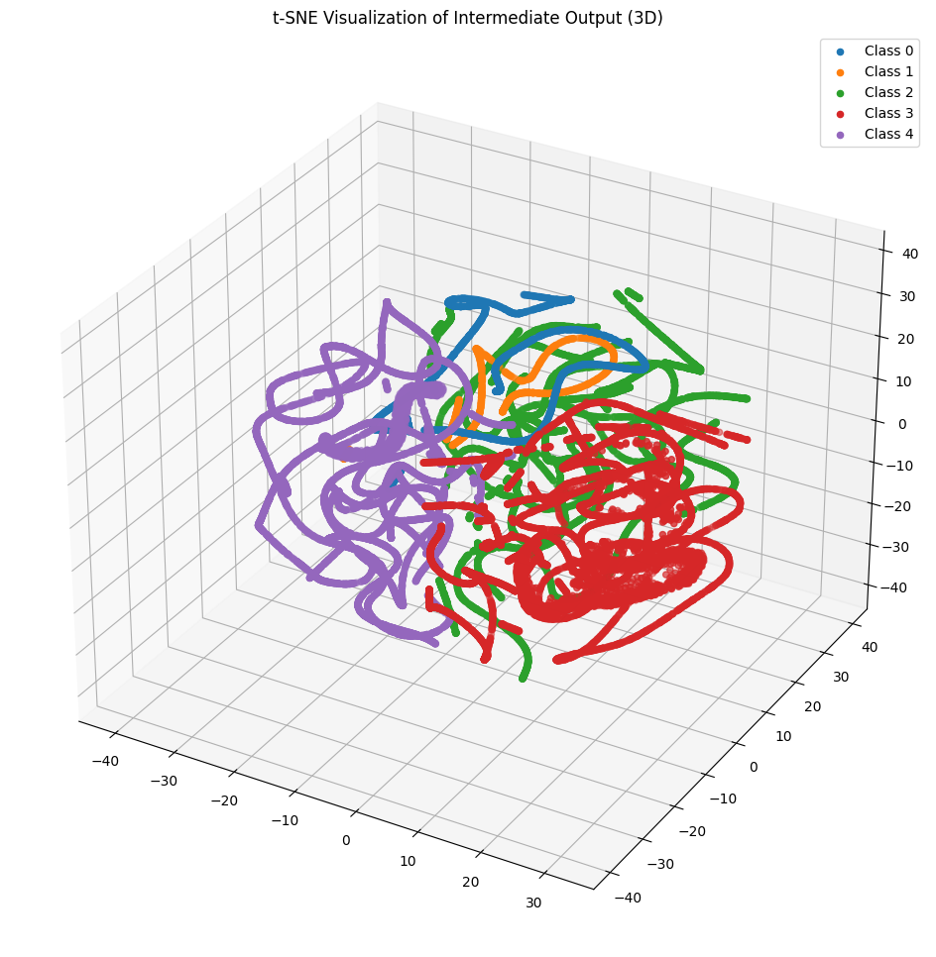
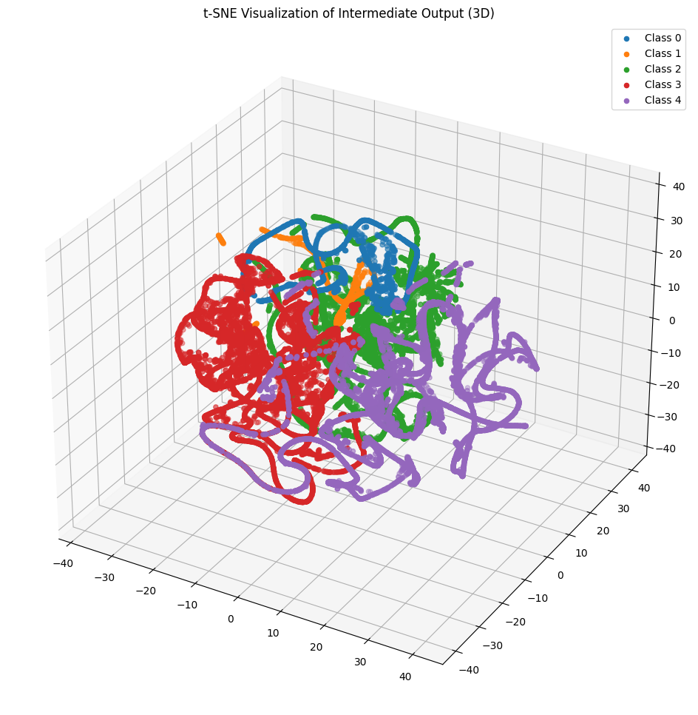
T-SNE of each output
Raw data
CNN
Transformer
MLP
Hybrid

Slide 33
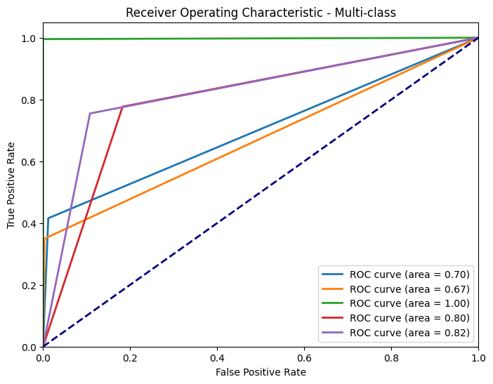
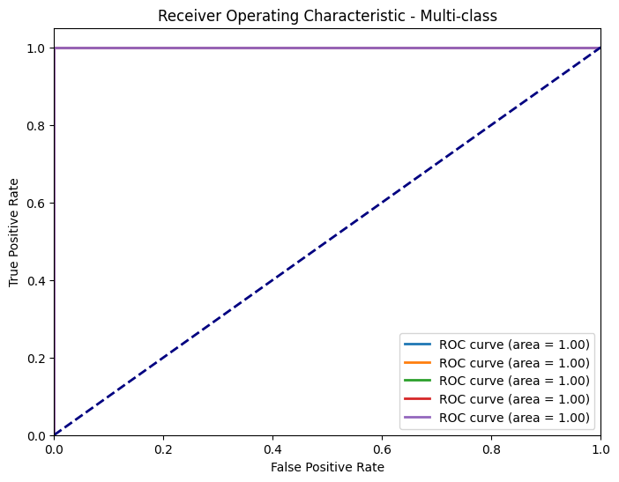
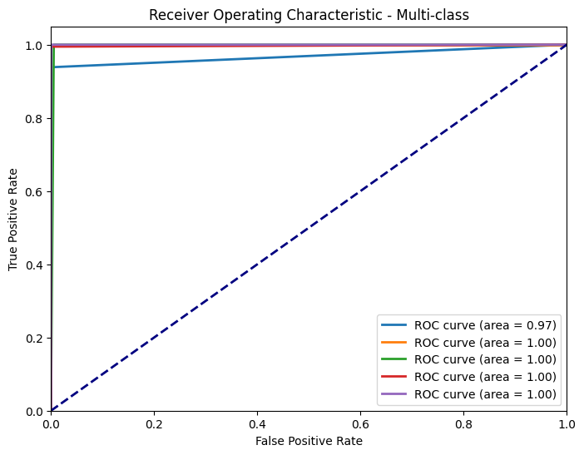
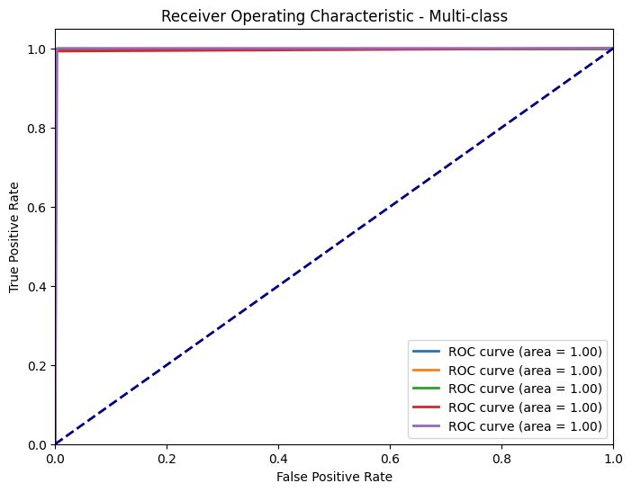
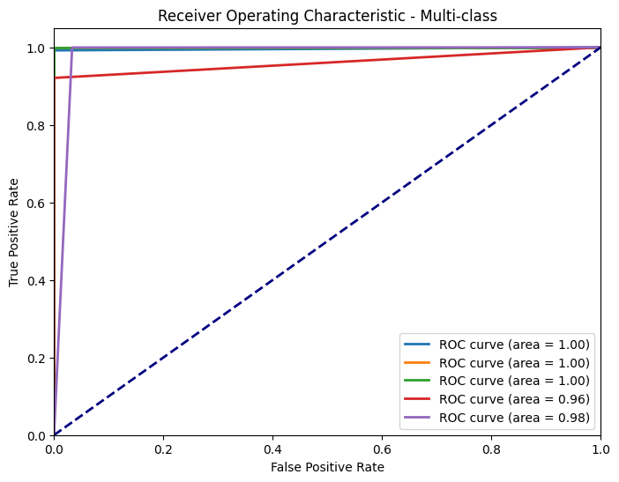
ROC of each output
KNN
CNN
Transformer
MLP
Hybrid

Slide 34



Numerical Comparison
p
l
d
Duration
Validation Loss
Repeatability
Time spent on development
Network simplicity
MLP: 82.37
CNN: 82.53
Hybrid: 143.52
Tr: 400.32
MLP: 0.0065
CNN: 0.0045
Hybrid: 0.0788
Tr: 0.0286
Transformer
CNN
Hybrid
MLP
Hybrid
MLP
Transformer
CNN
MLP
CNN
Hybrid
Transformer

Slide 35
b
Using CNN is a Better Option

Slide 36

b
R
&
f
z
c
Using GAN or VAE to balance the data
Finding a precise dimension reduction method
suggestion
d
(
I
4
H
'
6
8
Improving the Transformer network

Slide 37
Thanks for your attention

